Slide 1
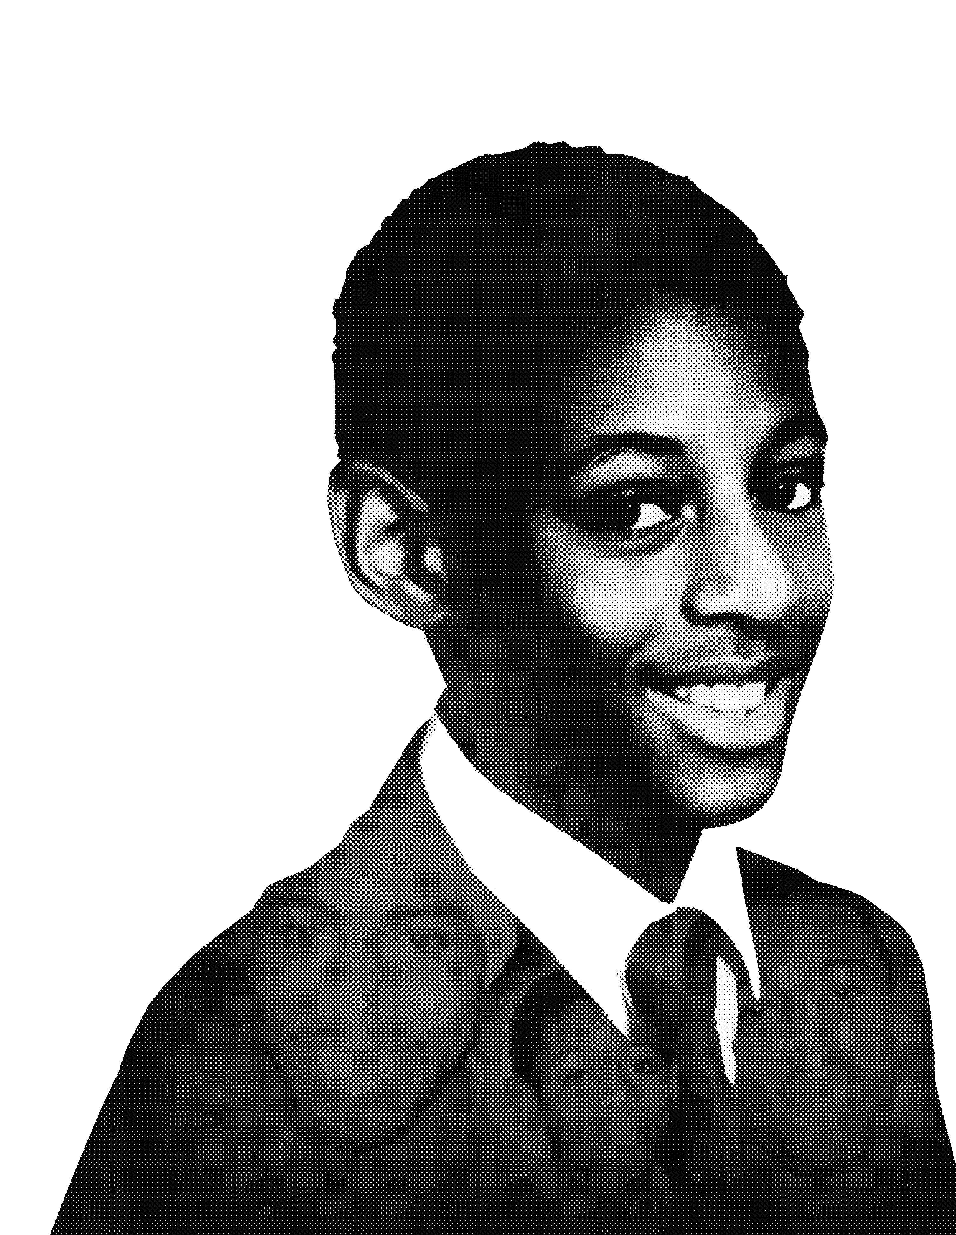
overview
secondary School Resource

Slide 2
pshe
At Key Stage 3 (Year 7, 8 & 9), students build on the knowledge and understanding, and skills learnt in their Primary years. Children are transitioning to Secondary education and becoming increasingly independent. Students will meet opportunities and challenges at this stage, whilst also going through puberty. We aim to cover relationships, social media and peer pressure.
At Key Stage 4 (Y 10 & 11), Students build on the KS 3 curriculum preparing to move towards
becoming more independent and taking on more responsibilities. We look at aspects of becoming adults and entering society as caring, kind and respectful citizens.
There are 3 core themes:
Health and Wellbeing
Relationships
Living in the wider world

Slide 3
Year 7
Wonderful me and my place in the world!
Why was Stephen special? Why am I special? Why was Stephen a good friend? How can I be a good friend? New beginnings at Secondary, new friends, choosing happy and supportive groups. How has isolation affected you and building new relationships? Positive and safe relationships online.
It’s good to be different.
What made Stephen stand out? What were his talents? How was he the same as you? How was he different to you? Do you have a talent or would you like to train to improve a talent? Stephen was good at drawing and enjoyed Maths & Music! Use of Maths, Music and Art to depict Stephen’s life in the timeline. What do prejudice and discrimination mean? Anti-Bullying and the SLDF 3 BS Believe in yourself, Blow the whistle and Ban Bullying! How was Stephen a kind person? What does it mean to be kind? How to be a good friend.
I have a dream! (Goals, hopes and ambitions)
Making good choices. What was it like for Stephen starting school? What is it like for you starting Y7? What are your hopes for secondary school? What was Stephen’s ambition? What are your goals and ambitions? How did Stephen settle in at school? Look at his strengths. What strengths and skills do you have? What job do you want to do and what skills will you need? Make a list of Acts of kindness in school.
Relationships with other people
Stephen’s family and friends. Look at relationship with family ie Mother/Father/ Brother/Sister Friendship with Elvin Oduro. Who are the special relationships in your life – Family and friends? Learning when to say no, scenarios in and out of school. What does it mean to have friends on-line? Safe internet use and E-safety relationships. What to do when things go wrong at school. Look at making good choices – Respect and kindness
Healthy lifestyles: Mind & Body
How was Stephen a role model in leading a healthy lifestyle? What sports activities was he good at. What are your sports and hobbies/interests? How does being active help you to manage stress? School sports day at Secondary – why was this special for Stephen? Can you make a contribution to your school sports day? What makes you stressful and who do you turn to? Saying not to drugs and misuse of substances. Harmful effects on body/mind.
Celebrating change and moving on.
What have been the best parts of moving to Secondary? What have been challenges and who has helped you? What are you looking forward to next? How did Stephen help others with charity work? Have you thought about fundraising? Choose a charity like Stephen did! (GOSH) Your changing emotions. How do you manage anxiety, stress, anger and conflict at Secondary school? How do you manage this out of school?

Slide 4
Year 8
Wonderful me and my place in the world!
What are the faiths and beliefs of those around me? Do I have a faith and belief? Celebrate diversity within your school? Can you learn something new about another culture? What other faiths exist in our community? Visit different places of worship. Presentation/video on what you have learnt. Positive self image of oneself.
It’s good to be different.
What is hate crime? What can I do if I see it? Have you suffered from unfairness/inequality? Look at injustice cases. Focus on Stephen’s timeline. Making a positive contribution – what clubs/organisations am I part of? Cadets. Stephen and Elvin designed caps and t-shirts. What can you do to make a difference in your school community/home? Litter picking/climate change/Entrepreneurs.
I have a dream! (Goals, hopes and ambitions)
How did Stephen and his friend earn money? Do you earn money through odd jobs? What does it mean to be an entrepreneur? Volunteering in community. Young enterprise initiative in school – Dragons Den! Designing something school/family will find useful that can be sold! Managing small amounts of money. Learning to save. Success in the community.
Relationships with other people
Self esteem – belief in yourself! You are as good as anyone. What was Stephen confident in? Why is it important to believe in yourself? Being a role model in your community. Negative influences in gangs/on-line activity. Timeline of what happened to Stephen. Negative peer pressure situations. Getting mixed up in the wrong crowd. ‘What if‘ situations. Following the crowd, standing up to bullies.
Healthy lifestyles: Mind & Body
Healthy lifestyle – Being the best that you can be! Sports challenges for charity! Drugs – What do I need to know? Peer pressure. What does gang culture mean? How can we stop knife crime? Presentations. Community relationship. Positive youth clubs/organisation. Cadets/Sports eg Football/Judo/Karate. Who are your role models for staying healthy in mind and body? Lewis Hamilton, Dina Asher-Smith
Celebrating change and moving on.
Healthy relationships with others. Acts of Kindness in community. Proud to be me! Song/Poem about Stephen. Use timeline and what has been learnt. Proud of role models in community –Doctors. Lawyers, nurses – How do we learn from them? Where to go for help if you experience discrimination with race, sexuality, gender. What if others do not accept you for who you are? M People –Moving on up!

Slide 5
Year 9
Wonderful me and my place in the world!
What is my place in the world? Accepting others for who they are. Why do some people find it hard to accept others. Self esteem/Insecurities. What to do when things go wrong at school. Look at knife crime/drugs/gangs. Basic first Aid.
It’s good to be different.
Racism – what is definition? Sexism and homophobia. Anti bullying. Anti Racism. What forms of discrimination exist? Debates on how we tackle all forms of discrimination/Debate. Do we know what it means to stereotype a certain section/group in society? Words matter! What is acceptable and how do we challenge name calling? When is enough? What to do when friends laugh along?
I have a dream! (Goals, hopes and ambitions)
What did Stephen dream of becoming? What qualifications do you need for your future career? What strengths and talents have I got to make it and what do I need to develop? Career guidance – link to SLDF Volunteering/Work experience. What am I looking forward to in GCSE choices?
Relationships with other people
During this Covid period how hard has it been for teenagers? What decisions have you had to make ? Maybe surrounding alcohol or drugs. Helping those around you. What if a friend has made wrong choices, how can you help? Gang culture – what is a gang?
Healthy lifestyles: Mind & Body
Mental health and stress with school/home life. Impact of Covid 19 and BAME communities – look at all students. Could some racism result from media coverage? Maintaining a healthy mind and worries during puberty. Staying safe as a teenager during pandemic. Managing risk and personal safety in new settings. Staying safe online. Diet/Sleep/Exercise habits.
Celebrating change and moving on.
Influencing others positively. How to help others understand that we should celebrate being different instead of making fun. We have more similarities than differences. Stephen was not in a gang – what influences people to join? Preparing for your GCSEs. The pressures that come with exams.

Slide 6
Year 10
Wonderful me and my place in the world!
How to live a safe life. (Laws) Personal safety when out with friends, especially in Covid times. Boundaries and managing relationships with parents and friends. The need for independence. Recognising when a situation is unsafe in the real world and online..
It’s good to be different.
Is society equal for everyone? How can you help to make school a fair place for all groups of people – race, ethnicity, gender, disability. How do we make equality for all? Look at public figures – Malala. How do we tackle racism in school and in society? Consequences of extremism and how to challenge incitement of violence and hate.
I have a dream! (Goals, hopes and ambitions)
Is the work place a fair place? Tackling inequality and discrimination in the workplace. What is institutional racism? Are there barriers to your own dreams/goals and ambitions? World of pilots / Engineers / Women in STEM.
Relationships with other people
Why do some people give in to peer pressure? Celebrating happy relationships in your life at home and in school. How can young people influence others about their cause – Greta Thunberg. When Friendships breakdown. What leads to risk taking? Ambassadors to younger pupils.
Healthy lifestyles: Mind & Body
Managing your own mental health, recognising when others may need help What does wellbeing mean? How do you manage your own well being. What does it mean to make the wrong choice? Look at situations where wrong choices are made. Drugs, knife crime, gang culture. Who influences you? Role models –Sporting heroes in community
Celebrating change and moving on.
What happened to Stephen – How did this affect his family and friends? Look at the consequences of our actions. One split decision in a gang – look at negative ripple effect on many lives. Risky situations, legal consequences Ripple effects of Kindness – Random Acts of Kindness

Slide 7
Year 11
Wonderful me and my place in the world!
What legislation affects 16-18 year olds? Are young people aware of the law? How responsible are you? Do you consider yourself to be ‘grown up’ Study scenarios – What would you do? Emergency first aid/Life saving skills
It’s good to be different.
What does it mean to be an ally? What does it mean to be anti-racist? What and who have you made a difference to? What is unconscious bias? Telling the truth – Speaking out! Blow whistle! Truth matters. Extreme views/Organisations – Recognise potential influence on people within your group.
I have a dream! (Goals, hopes and ambitions)
Can I achieve my goals now or do I need some support? What support do I need? What is my back up plan if things do not go to plan? Learn about Institutional racism – link to Stephen’s story. Has this changed?
Relationships with other people
Respecting my friends/ family and others in society. Roles peers play in supporting one another in resisting influences. Why do some join gangs? Acceptance. Exit strategies and where to seek support. Consequences of carrying weapons/Pressure to carry weapons. Truth, Respect and Fairness - Scenarios
Healthy lifestyles: Mind & Body
Work, rest and play! Timetables for revision and a work life balance plan. Exercise routine, Food diaries Relaxation activities. Recreational use of time. Smoking/Alcohol/drugs Influence in gangs. Effects of cyber crime. Positive use of social media.
Celebrating change and moving on.
Friendships and peer support. Transition into next phase of education/Apprenticeships. Careers interviews/Sponsors in community. Lifelong learning Give advice to your young Y7 self. What can we learn from Stephen’s story? What is his legacy? What comes next in the timeline?

Slide 8
The three cs
CLASSROOM
English, Maths, Art, Sports, History, Geography, Design Technology, Science, Music, Religious Education. All areas of the curriculum lend themselves to Stephen’s story. Schools can look at Black History, Windrush, Partition, Colonialism, throughout the year. Black inventors, Authors, Scientists, Historians, Mathematicians. Students can hold debates, presentations, social media, videos.
COMMUNITY
Talents in the wider community. Role models beyond the school gate. Fundraising/Charity/volunteering.
CAREERS
Education and bursaries. Sponsorship by Businesses in the community. Work experience.

Slide 9
Activities
Write down activities you will do as a class and school – Link them to the overview programme.
What will take place on April 22nd, Stephen Lawrence day?
What will take place throughout the rest of the year?

Slide 10
Community links
Who will you reach out to in your own communities?
What charity work will you embark on?
How will you spread the good work you do and the legacy of Stephen Lawrence?
How will you share your good work with other schools?
How will you measure your success?

Slide 11
THANK YOU
STEPHENLAWRENCEDAY.ORG
Stephen Lawrence Day Foundation, Kemp House, 152-160 City Road, London, EC1V 2NX
Copyright © 2020 Stephen Lawrence Day Foundation. All Rights Reserved. Charity Number 1187566.

